Slide 1
Immigration Strategies for Immigrant Entrepreneurs
David J. Kalson, Esq. Lawrence M. Lebowitz, Esq. January 31, 2023
Grow | Protect | Operate | Finance

Slide 2
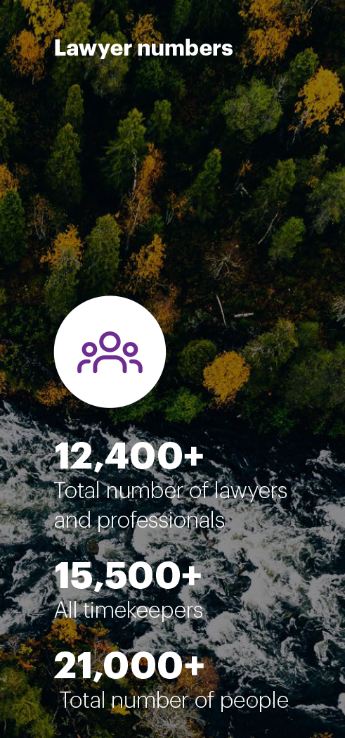
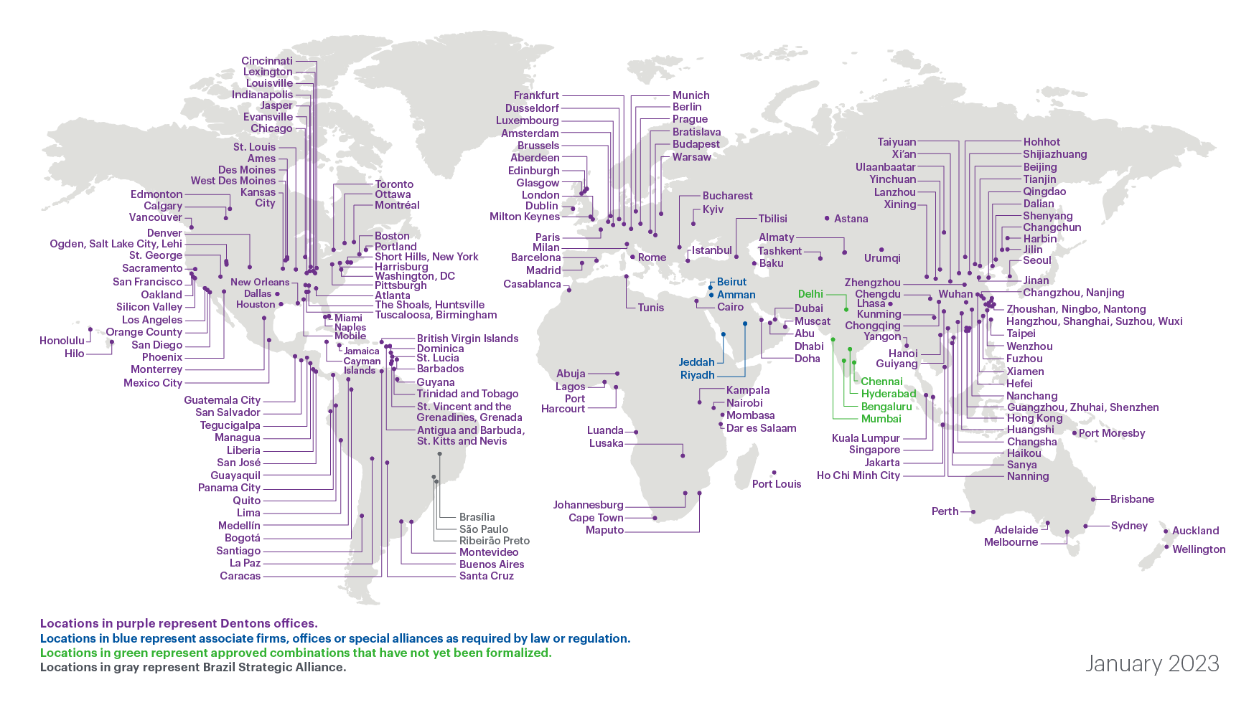
Dentons’ Global Presence
*Map and figures include combinations approved and announced in 2022

Slide 3
Foreign Students (F-1 Visa)
Business ownership/investment
Curricular Practical Training
Optional Practical Training
STEM OPT

Slide 4
H-1B “Specialty Occupation” Visas
Ownership of business – possible?
Beneficiary of H-1B petition
Basic requirements
Process
Timing/costs
H-1B “cap”/quota

Slide 5
E-2 “Treaty Investor” Visa
Ownership of business
Other requirements
How much money needs to be invested?
Immigration process
Not a path to a green card

Slide 6
Other Potential Nonimmigrant (Temporary) Visa Categories
TN (Trade NAFTA)
L-1 (Intracompany Transfer)
O-1 (“Extraordinary Ability”)

Slide 7
Green Cards – General
Standard process
Expedited process
Self-petition – possible?
Business/employment-related issues
Other things to know/consider

Slide 8
Standard Process
Labor certification
Immigrant visa petition
Adjustment of status
Timing
India/China
All other countries

Slide 9
Expedited Processes
EB-1A (“Extraordinary Ability”)
EB-2/NIW (“Advanced Degree Professional” and “National Interest Waiver”)
EB-5 (Investor visa)
Business-related factors for each

Slide 10
Entrepreneurial Visa Status/Options

Slide 11
Impact of President/Administration on Immigration
Trump Administration
Biden Administration (Year 2)
What does the future hold?

Slide 12
Questions?
David J. Kalson Shareholder +1 412 297 4975 david.kalson@dentons.com
Lawrence M. Lebowitz Shareholder +1 412 297 4979 larry.Lebowitz@dentons.com

Slide 13
Thank you!
Dentons is designed to be different. As the world's largest law firm with 20,000 professionals in over 200 locations in more than 80 countries, we can help you grow, protect, operate and finance your business. Our polycentric and purpose-driven approach, together with our commitment to inclusion, diversity, equity and ESG, ensures we challenge the status quo to stay focused on what matters most to you. www.dentons.com

