Slide 1
Immigration Strategies for Immigrant Entrepreneurs
David J. Kalson, Esq. Lawrence M. Lebowitz, Esq. January 23, 2024
Grow | Protect | Operate | Finance

Slide 2
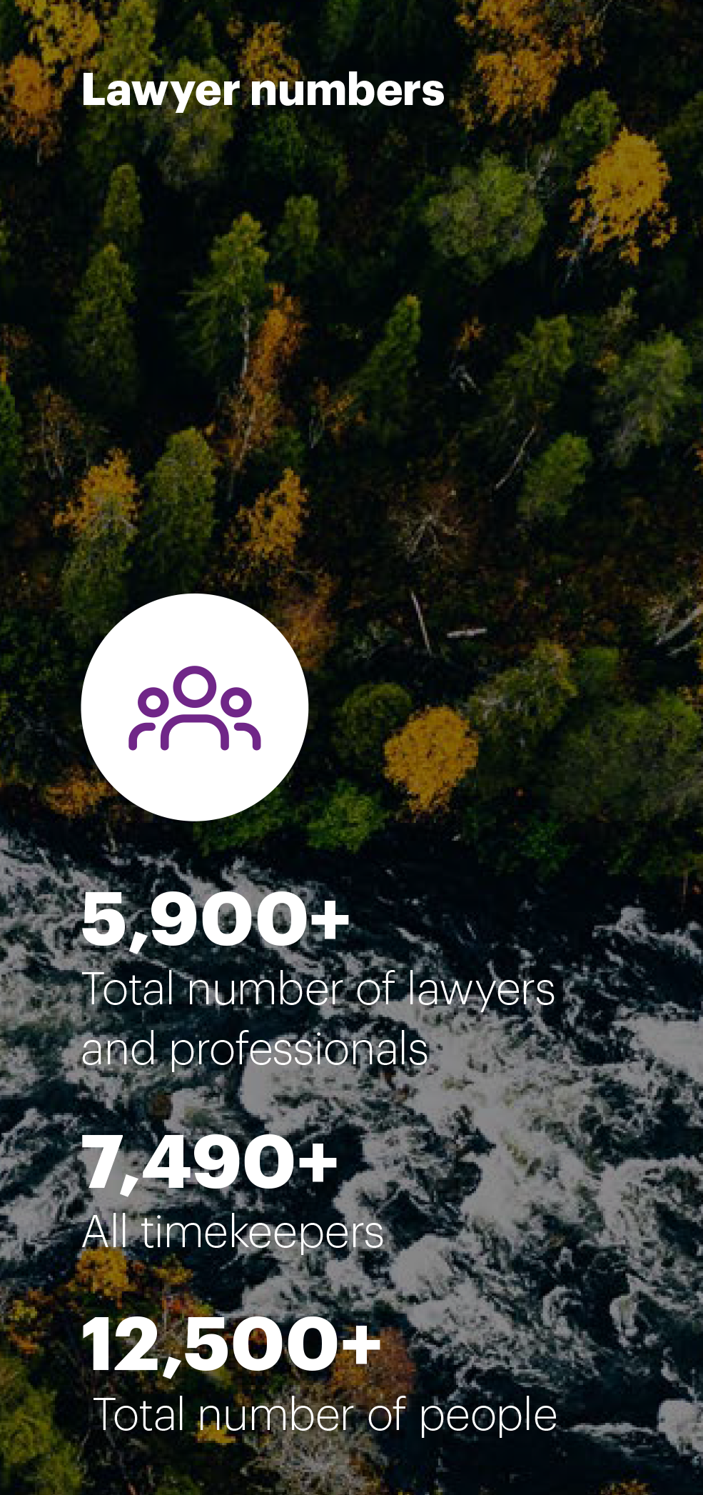
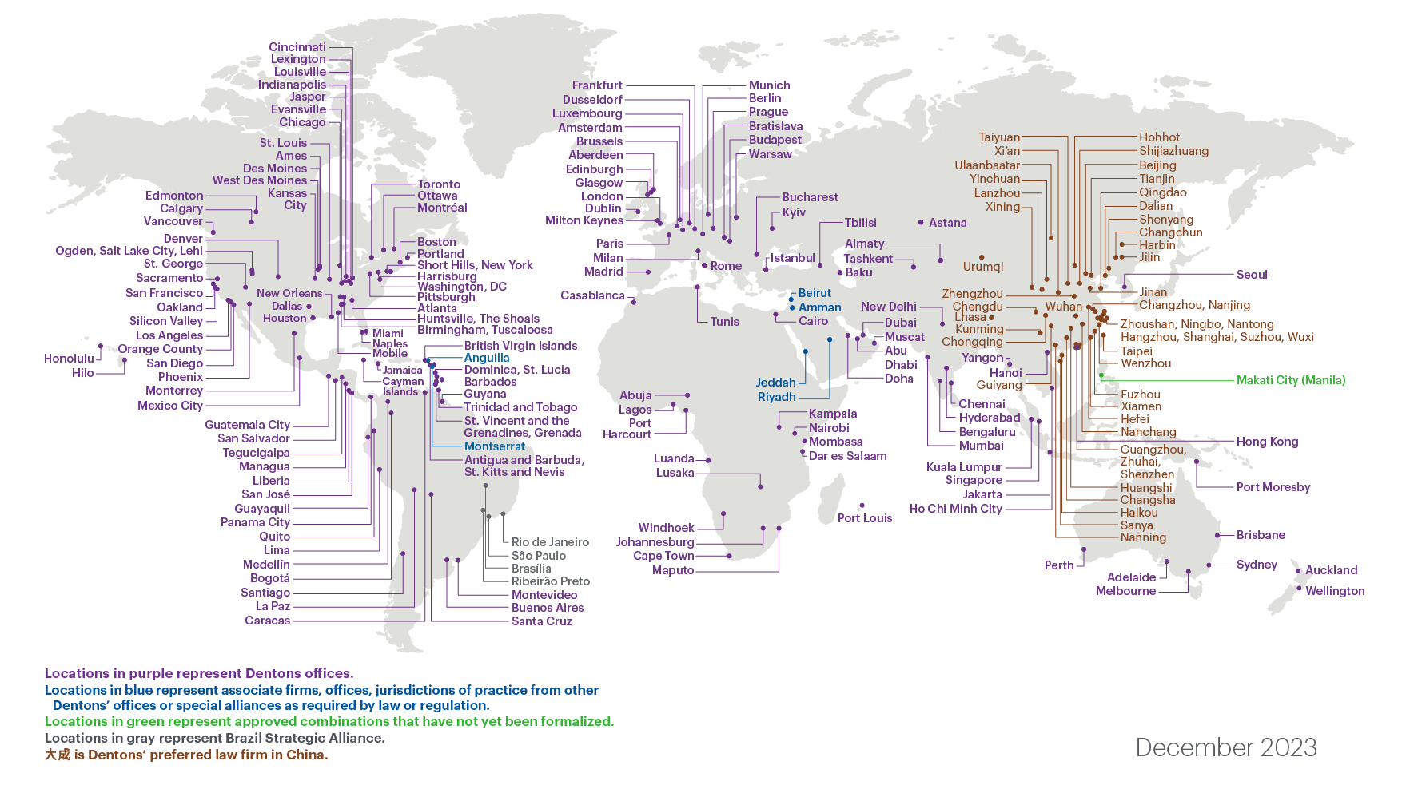
Dentons’ Global Presence
*Map and figures include combinations approved and announced in 2023

Slide 3
Foreign Students (F-1 Visa)
Business ownership/investment
Curricular Practical Training
Optional Practical Training
STEM OPT

Slide 4
H-1B “Specialty Occupation” Visas
Ownership of business – possible?
Beneficiary of H-1B petition
Basic requirements
Process
Timing/costs
H-1B “cap”/quota

Slide 5
E-2 “Treaty Investor” Visa
Ownership of business
Other requirements
How much money needs to be invested?
Immigration process
Not a path to a green card

Slide 6
Other Potential Nonimmigrant (Temporary) Visa Categories
TN (Trade NAFTA)
L-1 (Intracompany Transfer)
O-1 (“Extraordinary Ability”)

Slide 7
Green Cards – General
Standard process
Expedited process
Self-petition – possible?
Business/employment-related issues
Other things to know/consider

Slide 8
Standard Process
Labor certification
Immigrant visa petition
Adjustment of status
Timing
India/China
All other countries

Slide 9
Expedited Processes
EB-1A (“Extraordinary Ability”)
EB-2/NIW (“Advanced Degree Professional” and “National Interest Waiver”)
EB-5 (Investor visa)
Business-related factors for each

Slide 10
Entrepreneurial Visa Status/Options

Slide 11
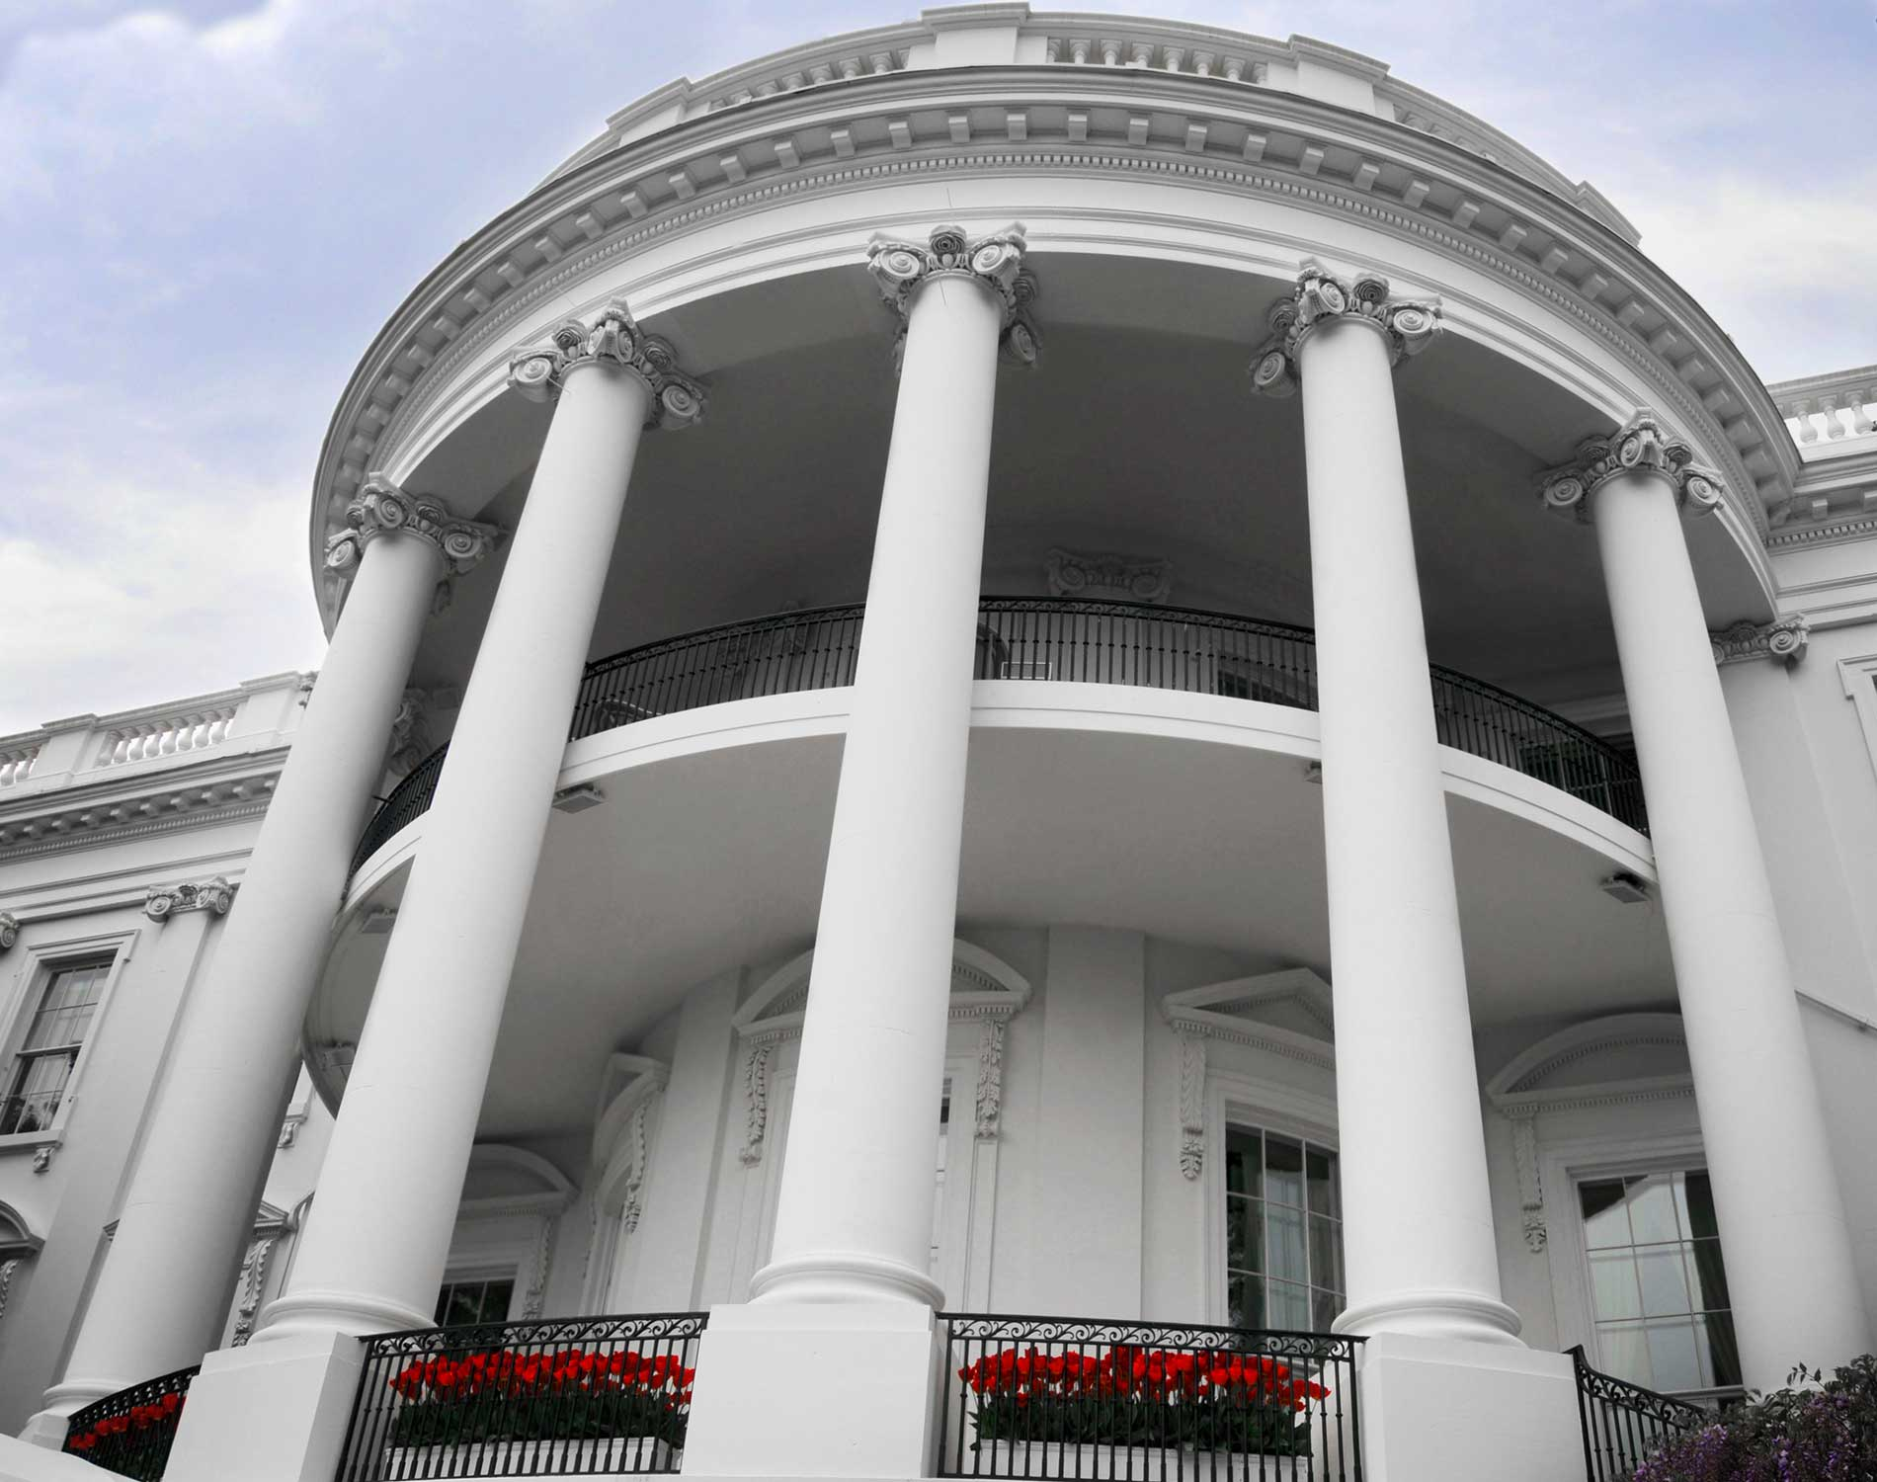
Impact of President/Administration on Immigration
Trump Administration
Biden Administration (Year 3)
What does the future hold?

Slide 12
Questions?
David J. Kalson Shareholder +1 412 297 4975 david.kalson@dentons.com
Lawrence M. Lebowitz Shareholder +1 412 297 4979 larry.Lebowitz@dentons.com

Slide 13
Thank you!
Across over 80 countries, Dentons helps you grow, protect, operate and finance your organization by providing uniquely global and deeply local legal solutions. Polycentric, purpose-driven and committed to inclusion, diversity, equity and sustainability, we focus on what matters most to you. www.dentons.com.

